Slide 1
CSE- 271 Software Engineering
Lecture -4

Slide 2
Topics covered
Process activities
  Software specification
  Software design and implementation
  Software validation
  Software evolution

Slide 3
Software specification
The process of establishing what services are required and the constraints on the system’s operation and development.
Requirements engineering process
  Feasibility study;
  Requirements elicitation and analysis;
  Requirements specification;
  Requirements validation.

Slide 4
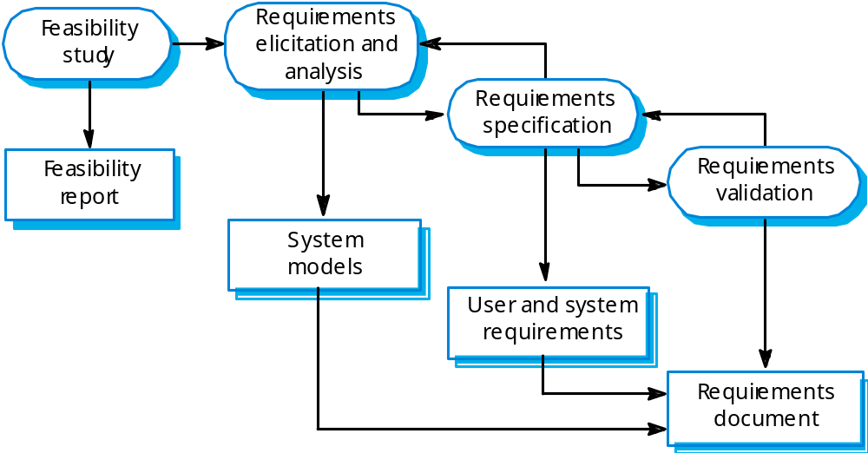
The requirements engineering process

Slide 5
SRS Document
An SRS (Software Requirements Specification) is basically an organization's understanding (in writing) of a customer or potential client's system requirements and dependencies to any actual design or development work. It's a two-way insurance policy that assures that both the client and the organization understand the other's requirements from that perspective at a given point in time.
The SRS document itself states in precise and explicit language those functions and capabilities a software system (i.e. a software application, an eCommerce Web site, and so on) must provide, as well as states any required constraints by which the system must abide.

Slide 6
Software design and implementation
The process of converting the system specification into an executable system.
Software design
  Design a software structure that realises the specification;
Implementation
  Translate this structure into an executable program;
The activities of design and implementation are closely related and may be inter-leaved.

Slide 7
Design process activities
Architectural design
Abstract specification
Interface design
Component design
Data structure design
Algorithm design

Slide 8
Architectural design
Design information provided is minimal
  System is simply decomposed into interacting subsystems or modules
Identify Subsystems and Modules
Example: Program Submission System
  Server
  Teacher Interface
  Student Interface

Slide 9
Abstract specification
Identify services and constraints per subsystem
Example: Server
  set up a class
  set up a project
  submit a program
Note: descriptions of services are informal

Slide 10
Interface design
Services per subsystem are formally specified
Goal: provide unambiguous information regarding extent of external interaction
  parameters/inputs, return values/outputs
Per subsystem, specify its interface
  collection of available functions/methods for use by other subsystems
Example: Server
  function: set_up_class
  parameters: catnum, section, list of students (id#’s and names)

Slide 11
Component design
Within a subsystem
  determine components
  per component, identify services/interfaces
Understand interaction between components at the level of the subsystem
OO Design: components are classes
Design models (using the UML, for example) are most useful at this level

Slide 12
Data Structure Design & Algorithm Design
Specify data structures and algorithms (for methods) of the individual components (classes)
Generally still implementation-independent
  Although though in practice, specific language features are used
  Techniques: Pseudocode, flowcharts, others

Slide 13
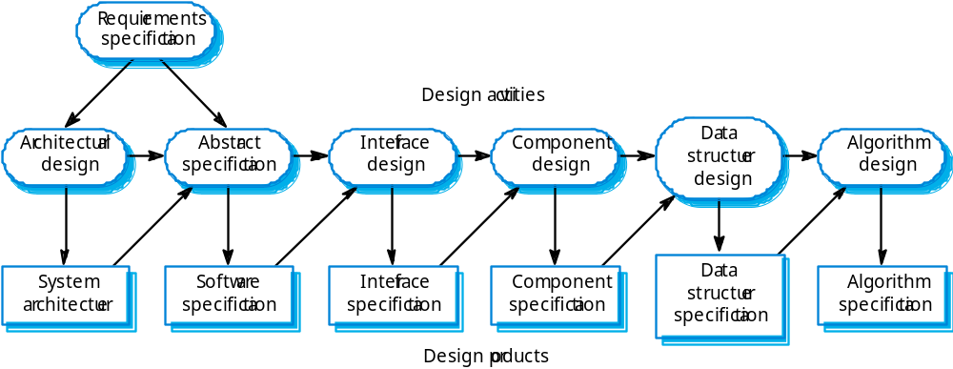
The software design process

Slide 14
Structured methods
Systematic approaches to developing a software design.
The design is usually documented as a set of graphical models.
Possible models
  Object model;
  Sequence model;
  State transition model;
  Structural model;
  Data-flow model.

Slide 15
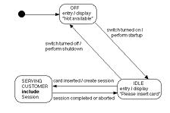
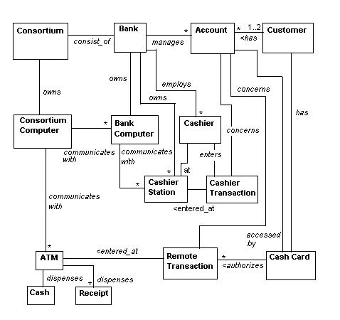
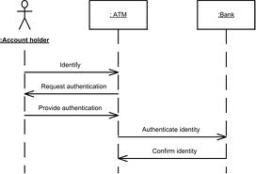
Possible Models (ATM Example)
State Transition Model
Object Model
Sequence Model

Slide 16
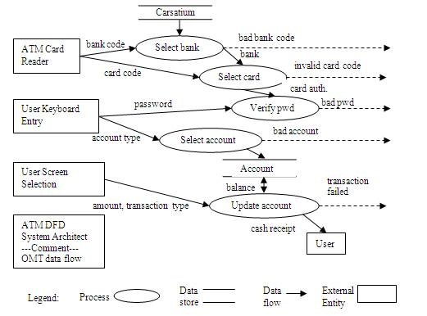
Possible Models (ATM Example)
Data Flow Model

Slide 17
Programming and debugging
Translating a design into a program and removing errors from that program.
Programming is a personal activity - there is no generic programming process.
Programmers carry out some program testing to discover faults in the program and remove these faults in the debugging process.

Slide 18
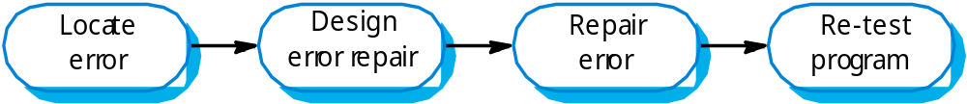
The Debugging Process

Slide 19
Software validation
Verification and validation (V & V) is intended to show that a system conforms to its specification and meets the requirements of the system customer.
Involves checking and review processes and system testing.
System testing involves executing the system with test cases that are derived from the specification of the real data to be processed by the system.

Slide 20
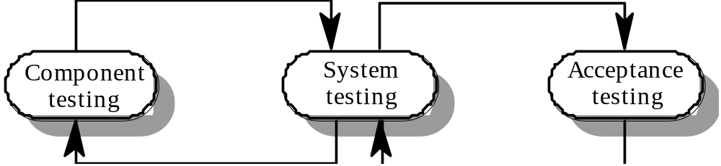
The Testing Process

Slide 21
Testing stages
Component or unit testing
  Individual components are tested independently;
  Components may be functions or objects or coherent groupings of these entities.
System testing
  Testing of the system as a whole. Finding errors that result from unanticipated interaction between components .
Acceptance testing
  Testing with customer data to check that the system meets the customer’s needs. This is also called alpha testing.
Another form of testing called Beta Testing involves delivering a system to potential customers and get feedback from them.

Slide 22
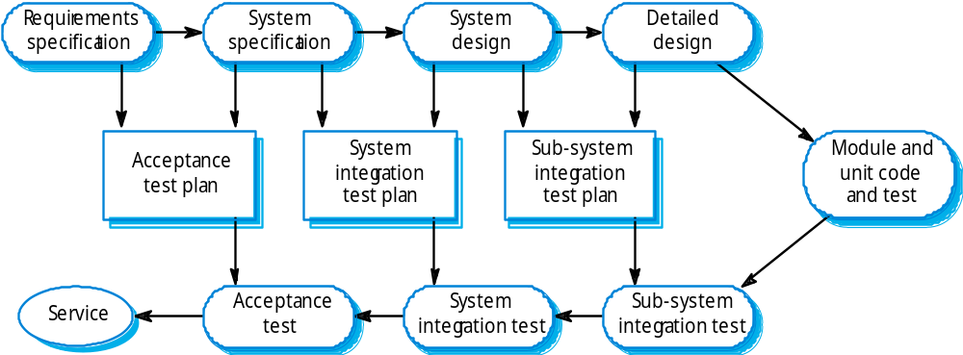
Testing phases

Slide 23
Software evolution
Software is inherently flexible and can change.
As requirements change through changing business circumstances, the software that supports the business must also evolve and change.
Although there has been a demarcation between development and evolution (maintenance) this is increasingly irrelevant as fewer and fewer systems are completely new.

Slide 24
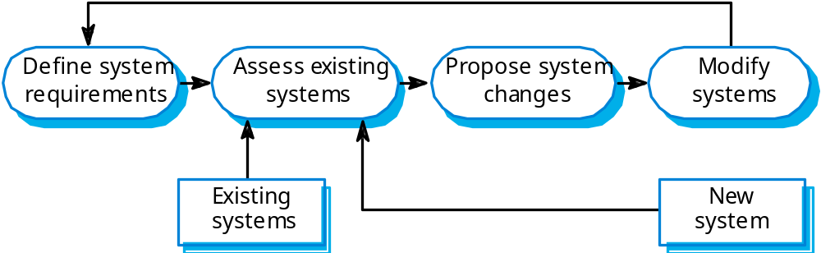
System evolution

